Slide 1

director briefing document
March 2019

Slide 2
Agenda
1 | Company Overview
2 | Board Bios
3 | Executive Bios
4 | Board Calendar
5 | Director Compensation

Slide 3
Company Overview
Section 1

Slide 4
Company Overview
Microsoft is a technology company whose mission is to empower every person and every organization on the planet to achieve more. The company strives to create local opportunity, growth, and impact in every country around the world. Its platforms and tools help drive small business productivity, large business competitiveness, and public- sector efficiency. They also support new startups, improve educational and health outcomes, and empower human ingenuity.
Founded in 1975, Microsoft develops and supports software, services, devices, and solutions that deliver new value for customers and help people and businesses realize their full potential. The company’s products include operating systems; cross- device productivity applications; server applications; business solution applications; desktop and server management tools; software development tools; and video games. Microsoft also designs, manufactures, and sells devices, including PCs, tablets, gaming and entertainment consoles, other intelligent devices, and related accessories.
Additionally, the company offers an array of services, including cloud- based solutions that provide customers with software, services, platforms, and content, and we provide solution support and consulting services. They also deliver relevant online advertising to a global audience.
The company’s growth depends on securely delivering continuous innovation and advancing our leading productivity and collaboration tools and services, including Office, Microsoft Dynamics, and LinkedIn. Microsoft 365 brings together Office 365, Windows 10, and Enterprise Mobility + Security to help organizations empower their employees with AI- backed tools that unlock creativity, increase teamwork, and fuel innovation, all the while enabling compliance coverage and data protection. Microsoft Teams is core to the company’s vision for the modern workplace as the digital hub that creates a single canvas for teamwork, conversations, meetings, and content. Microsoft Relationship Sales solution brings together LinkedIn Sales Navigator and Dynamics to transform business to business sales through social selling. Dynamics 365 for Talent with LinkedIn Recruiter and Learning gives human resource professionals a complete solution to compete for talent.
To execute current corporate strategy, Microsoft’s research and development efforts are focused on three interconnected ambitions: reinventing productivity and business processes; building the intelligent cloud platform; and creating more personal computing. In addition, there are several distinct areas of technology that the company aims to drive forward, with the goal to be the industry leader over the long term, translating to sustained growth. Microsoft is therefore investing significant resources in: delivering new productivity and business processes to improve how people communicate; building and running cloud-based services in ways that unleash new experiences and opportunities for businesses and individuals; establishing the Windows platform across servers and devices to unify the cross-device user experience, and increase agility when bringing new advances to market; developing new devices that have increasingly natural ways to interact with them; and applying machine learning to make technology more intuitive.
Source: Company Annual Report (2018), Company Annual 10-K Filing (2018) and S&P CapitalIQ

Slide 5
Company Overview (continued)
On June 4, 2018, Microsoft announced plans to acquire GitHub, Inc., a service that millions of developers around the world rely on to write code together. The acquisition is expected to close by the end of the calendar year.
Microsoft operates its business and reports its financial performance using three segments: Productivity and Business Processes, Intelligent Cloud, and More Personal Computing. Its segments provide management with a comprehensive financial view of its key businesses. The segments enable the alignment of strategies and objectives across the development, sales, marketing, and services organizations, and they provide a framework for timely and rational allocation of resources within businesses.
The Productivity and Business Processes segment consists of products and services in the portfolio of productivity, communication, and information services, spanning a variety of devices and platforms.
The Intelligent Cloud segment consists of the public, private, and hybrid server products and cloud services that can power modern business.
The More Personal Computing segment consists of products and services geared towards harmonizing the interests of end users, developers, and IT professionals across screens of all sizes.
Microsoft has operations centers that support all operations in their regions, including customer contract and order processing, credit and collections, information processing, and vendor management and logistics. The company markets and distributes its products and services via OEMs, distributors and resellers, online, and Microsoft retail stores.
Microsoft’s success is based on the ability to create new and compelling products, services, and experiences for users. The company therefore invests in a range of emerging technology trends and breakthroughs, maintaining commitment to research and development across a wide spectrum of technologies, tools, and platforms. During fiscal years 2018, 2017, and 2016, research and development expense was $14.7 billion, $13.0 billion, and $12.0 billion, respectively. These amounts represented 13% of revenue in fiscal years 2018, 2017, and 2016. Microsoft plans to continue to make significant investments in a broad range of research and development efforts.
Source: Company Annual Report (2018), Company Annual 10-K Filing (2018) and S&P CapitalIQ

Slide 6
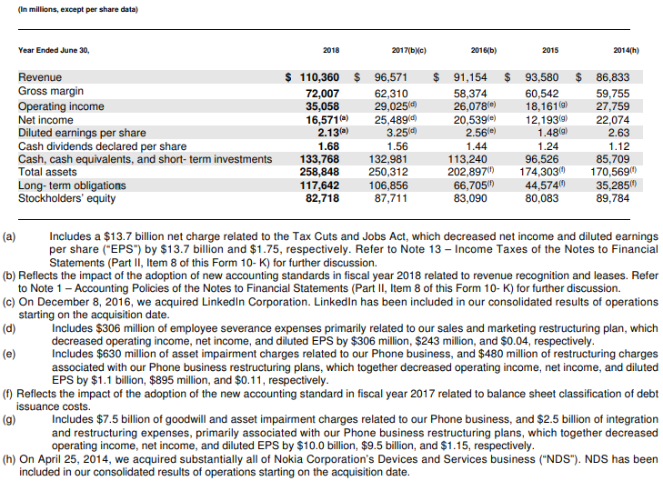
Company Overview (continued)
Financial Performance
Source: Company 10-K Filing (2018)

Slide 7
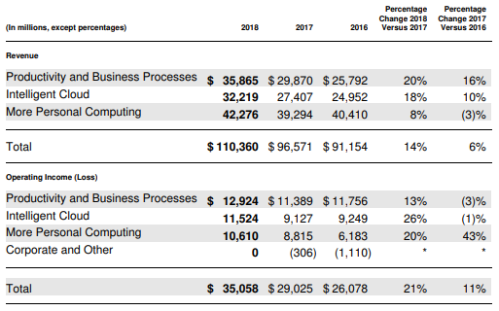
Company Overview (continued)
Segment Performance
Source: Company 10-K Filing (2018)

Slide 8
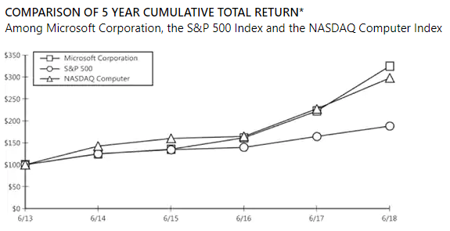
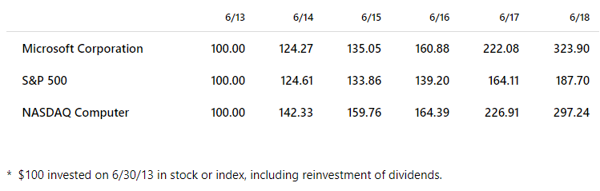
Company Overview (continued)
Stock Performance
Source: Company Annual Report (2018)

Slide 9
Board Bios
Section 2

Slide 10
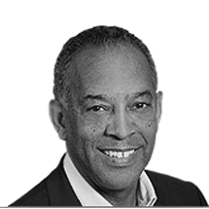
Board Bios
John W. Thompson
Chairman
John W. Thompson joined the Microsoft Board in February 2012, and became independent chairman of Microsoft Corporation on February 4, 2014.
Thompson brings over 40 years of experience in the technology industry. Most recently, he served as chief executive officer of Virtual Instruments, a privately held company. Prior to this, he was the chief executive officer of Symantec for 10 years, during which time he helped transform the company into a leader in security, storage and systems management solutions. Thompson also held several leadership positions during his 28 years at IBM in the areas of sales, marketing and software development, and he also served as general manager of IBM Americas.
Since 2009, Thompson has been an active investor in early-stage technology companies in the Silicon Valley. He currently serves as either an advisor or board member with Illumina, ReviverMX and Illumio. Previously, he served on the boards of NIPSCO (Northern Indiana Public Service Company), Fortune Brands, Liquid Robotics, Seagate Technologies, and United Parcel Service (UPS).
In addition to his services in the technology industry, he is also a member of the board of trustees for the Wetland America Trust. He has served on the national board of Teach for America and on several government commissions that include the Financial Crisis Inquiry Commission, the National Infrastructure Advisory Committee, and the Silicon Valley Blue Ribbon Task Force on Aviation Security and Technology.
Thompson received a bachelor’s degree in business administration from Florida A&M University, and a master’s degree in management science from MIT’s Sloan School of Management. In 2008, he received an honorary doctorate degree from the University of Notre Dame, Mendoza College of Business, and in 2014 he received an honorary doctorate degree from Florida A&M University.
Read more at https://news.microsoft.com/exec/john-w-thompson/#w8yqy3osQedttc2r.99

Slide 11
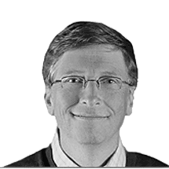
Board Bios
Bill Gates
Founder and Technology Advisor
William (Bill) H. Gates is founder, technology advisor and board member of Microsoft Corporation, the worldwide leader in software, services and solutions that help people and businesses realize their full potential. He served as chairman of the board until Feb. 4, 2014.
On June 27, 2008, Gates transitioned out of a day-to-day role in the company to spend more time on his global health and education work at the Bill & Melinda Gates Foundation. He shares his thoughts about the foundation and other topics on Gates Notes, a website launched in January 2010. Gates continues to serve on Microsoft’s Board of Directors and as an advisor on key development projects.
Born on Oct. 28, 1955, Gates grew up in Seattle with his two sisters. Their father, William H. Gates II, is a Seattle attorney. Their late mother, Mary Gates, was a schoolteacher, University of Washington regent, and chairwoman of United Way International.
Gates attended public elementary school and the private Lakeside School. There, he discovered his interest in software and began programming computers at age 13.
In 1973, Gates entered Harvard University as a freshman, where he lived down the hall from Steve Ballmer. While at Harvard, Gates developed a version of the programming language BASIC for the first microcomputer – the MITS Altair.
In his junior year, Gates left Harvard to devote his energies to Microsoft, a company he had begun in 1975 with his childhood friend Paul Allen. Guided by a belief that the computer would be a valuable tool on every office desktop and in every home, they began developing software for personal computers. Gates’ foresight and his vision for personal computing have been central to the success of Microsoft and the software industry.
Under Gates’ leadership, Microsoft’s mission has been to continually advance and improve software technology, and to make it easier, more cost-effective and more enjoyable for people to use computers. The company is committed to a long-term view, reflected in its industry-leading investment in research and development each year.

Slide 12
Board Bios
Bill Gates, continued
Founder and Technology Advisor
In 1999, Gates wrote “Business @ the Speed of Thought,” a book that shows how computer technology can solve business problems in fundamentally new ways. The book was published in 25 languages and is available in more than 60 countries. “Business @ the Speed of Thought” has received wide critical acclaim, and was listed on the best-seller lists of the “New York Times,” “USA Today,” “The Wall Street Journal” and on Amazon.com. Gates’ previous book, “The Road Ahead,” published in 1995, was at the top of the “New York Times” bestseller list for seven weeks.
Gates has donated the proceeds of both books to non-profit organizations that support the use of technology in education and skills development.
In addition to his love of computers and software, Gates founded Corbis, which is developing one of the world’s largest resources of visual information – a comprehensive digital archive of art and photography from public and private collections around the globe. He is also a member of the board of directors of Berkshire Hathaway Inc., which invests in companies engaged in diverse business activities.
Philanthropy is very important to Gates. He and his wife, Melinda, started a foundation in 2000 to help reduce inequities in the United States and around the world. The Bill & Melinda Gates Foundation supports philanthropic initiatives in the areas of global health and learning, with the hope that in the 21st century, advances in these critical areas will be available for all people. To learn more about the foundation, visit www.gatesfoundation.org
Gates was married on Jan. 1, 1994, to Melinda French Gates. They have three children. Gates is an avid reader, and enjoys playing golf, tennis and bridge.
Read more at https://news.microsoft.com/exec/bill-gates/#wovuOEm0dRUd4i27.99

Slide 13
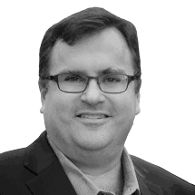
Board Bios
Reid Hoffman
Partner, Greylock Partners
Reid Hoffman is an accomplished entrepreneur, executive, and investor, and has played an integral role in building many of today’s leading consumer technology businesses, including LinkedIn and PayPal. Hoffman joined Greylock Partners in 2009, where he focuses on building products that can reach hundreds of millions of participants and businesses that have network effects. In 2003 he co-founded LinkedIn, the world’s largest professional networking service. He led LinkedIn through its first four years and to profitability as Chief Executive Officer. Prior to LinkedIn, he served as executive vice president at PayPal, where he was also a founding board member.
Hoffman joined the Microsoft Board in March 2017, and also serves on the boards of several private companies including Edmodo, Convoy, Blockstream. In addition, he serves on several not-for-profit boards, including Wrapp and Kiva.org, and chairs the West Coast advisory board for QuestBridge.
Hoffman earned a master’s degree in philosophy from Oxford University, where he was a Marshall Scholar, and a bachelor’s degree with distinction in symbolic systems from Stanford University.
Read more at https://news.microsoft.com/exec/reid-hoffman/#UeQhEyTGhVU9DIeo.99

Slide 14
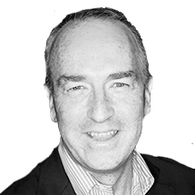
Board Bios
Hugh Johnston
Vice Chairman and Chief Financial Officer, PepsiCo
Hugh Johnston is vice chairman and chief financial officer of PepsiCo, a global food and beverage company that maintains a product portfolio that includes 22 brands.
Johnston joined PepsiCo in 1987, and has served in a variety of senior leadership positions, including executive vice president of global operations, president of Pepsi-Cola North America, senior vice president of transformation, senior vice president and chief financial officer, and senior vice president of mergers and acquisitions.
Johnston joined the Microsoft board of directors in September 2017. He also serves on the University of Chicago’s Booth School CFO Advisory Board, Syracuse University’s Whitman School of Management Advisory Council, and as director for the Peterson Institute for International Economics.
Johnston holds a bachelor of science from Syracuse University and an MBA from the University of Chicago.
Read more at https://news.microsoft.com/exec/hugh-johnston/

Slide 15
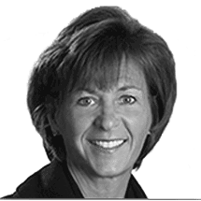
Board Bios
Teri L. List-Stoll
Executive Vice President and Chief Financial Officer, Gap, Inc.
Teri List-Stoll is the executive vice president and chief financial officer at Gap, Inc. She joined the Microsoft Board as a nonexecutive director in October 2014. She is a member of the company’s Audit and Regulatory and Public Policy Committees.
Recently, List-Stoll served as the executive vice president and chief financial officer of Dick’s Sporting Goods Inc., where she oversaw the finance and legal organization. Prior to this, she served as executive vice president and chief financial officer at Kraft Foods Group, from September 2013 to March 2015, and then as a senior advisor through May 2015. As CFO of Kraft, she led the organizations of finance, information services and business process excellence. Her responsibilities included financial planning, accounting and reporting, internal audit, treasury, tax, acquisitions and divestitures, and investor relations. In 1994, List-Stoll joined Proctor & Gamble (P&G) progressing to senior vice president and treasurer. From 1991 to 1993, she was a fellow with the Financial Accounting Standards Board (FASB), and before this she spent over nine years at Deloitte & Touche LLP, where she provided financial counsel to large multinational companies.
List-Stoll serves on the board and audit committee of Danaher Corporation. She has a bachelor’s degree in accounting from Northern Michigan University and is a certified public accountant.
Read more at https://news.microsoft.com/exec/teri-l-list-stoll/#0EG1RmOsYJbSt1zL.99

Slide 16
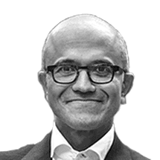
Board Bios
Satya Nadella
Chief Executive Officer
Satya Nadella is Chief Executive Officer of Microsoft. Before being named CEO in February 2014, Nadella held leadership roles in both enterprise and consumer businesses across the company.
Joining Microsoft in 1992, he quickly became known as a leader who could span a breadth of technologies and businesses to transform some of Microsoft’s biggest product offerings.
Most recently, Nadella was executive vice president of Microsoft’s Cloud and Enterprise group. In this role he led the transformation to the cloud infrastructure and services business, which outperformed the market and took share from competition. Previously, Nadella led R&D for the Online Services Division and was vice president of the Microsoft Business Division. Before joining Microsoft, Nadella was a member of the technology staff at Sun Microsystems.
Originally from Hyderabad, India, Nadella lives in Bellevue, Wash. He earned a bachelor’s degree in electrical engineering from Mangalore University, a master’s degree in computer science from the University of Wisconsin – Milwaukee and a master’s degree in business administration from the University of Chicago. Nadella serves on the board of trustees to Fred Hutchinson Cancer Research Center as well as the Starbucks Board of Directors. He is married and has three children.
Read more at https://news.microsoft.com/exec/satya-nadella-2/#DD58Z7tXFasEpgkW.99

Slide 17
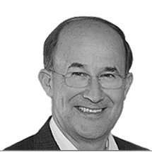
Board Bios
Charles H. Noski
Former Vice Chairman, Bank of America Corporation
Mr. Noski retired as vice chairman of Bank of America Corporation in September 2012. From May 2010 through June 2011, he served as executive vice president and chief financial officer, with responsibility for all finance functions as well as Corporate Treasury, Global Corporate Strategy Planning and Development, Investor Relations, Corporate Investments and Global Principal Investments. Mr. Noski joined the Microsoft Board in November 2003, and also serves on the boards of directors of Avon Products, Inc., The Priceline Group Inc., and the National Association of Corporate Directors.
From 1999 to 2002, Mr. Noski served as senior executive vice president and chief financial officer of AT&T Corporation, and retired as vice chairman of the board of directors upon the completion of AT&T’s restructuring in November 2002. From 2003 to 2005, Mr. Noski was corporate vice president and chief financial officer of Northrop Grumman Corporation, and was a director from 2002 to 2005. Prior to joining AT&T, Mr. Noski was president, chief operating officer, and a member of the board of directors of Hughes Electronics Corporation, a publicly-traded subsidiary of General Motors Corporation in the satellite and wireless communications business. Since 2000, he has also served for various periods on the boards of directors of Air Products & Chemicals, Inc., Automatic Data Processing, Inc., Avery Dennison Corporation, and Morgan Stanley.
Mr. Noski is chairman of the board of trustees of the Financial Accounting Foundation, a member of the American Institute of Certified Public Accountants and Financial Executives International, and a past member of the Standing Advisory Group of the Public Company Accounting Oversight Board.
Read more at https://news.microsoft.com/exec/charles-h-noski/#8KBcZAIpQLUQMbO0.99

Slide 18
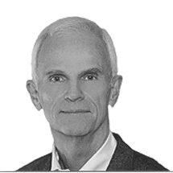
Board Bios
Dr. Helmut Panke
Former Chairman of the Board of Management, BMW AG
Dr. Panke joined the Microsoft Board as a nonexecutive director on November 11, 2003. He is chairman of the company’s Regulatory and Public Policy Committee and member of the Audit Committee.
In 1982, Dr. Panke joined BMW Bayerische Motoren Werke AG and held a variety of positions during his tenure. Most recently, he served as the company’s chairman of the board of management from 2002 to 2006. From 1999 to 2002, he served on the board of management for finance, and from 1996 to 1999 he served on the board of management for human resources and information technology. Prior to this, from 1993 to 1996, he was responsible for the company’s North American activities as the chairman and CEO of BMW (U.S.) Holding Corp.
Dr. Panke currently also serves on the board of directors for Singapore Airlines Limited.
Read more at https://news.microsoft.com/exec/dr-helmut-panke/#dDrquRDlbUebjWzW.99

Slide 19
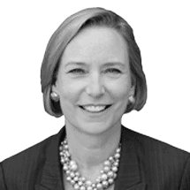
Board Bios
Sandra E. Peterson
Former Group Worldwide Chairman, Johnson & Johnson
Sandra (Sandi) E. Peterson served as group worldwide chairman for Johnson & Johnson, the world’s largest broadly based healthcare company, where her portfolio included the company’s global operating infrastructure, multiple consumer-facing businesses and key strategic initiatives.
From 2005 to 2012 Peterson had an extensive global career in healthcare, life sciences, consumer goods and consulting. Most recently she was chairman and CEO of Bayer CropScience AG in Germany. She worked for Medco Health Solutions Inc. (formerly Merck-Medco) from 1999 to 2004.
Peterson was a member of the board of directors of The Dun & Bradstreet Corp. where she chaired the Innovation & Technology Committee. Peterson holds a B.A. from Cornell University and an M.P.A. from Princeton University.
Peterson joined the Microsoft board as an independent director in December 2015.
Read more at https://news.microsoft.com/exec/sandra-e-peterson/#ZWrTD6GO412qAFjW.99

Slide 20
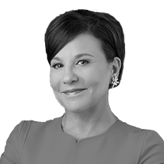
Board Bios
Penny Pritzker
Founder & Chairman, PSP Partners
Penny Pritzker is an entrepreneur, civic leader and philanthropist with more than 30 years of experience as a business builder and entrepreneur in numerous industries. Pritzker is the founder and chairman of PSP Partners and its affiliates Pritzker Realty Group, PSP Capital and PSP Growth.
From June 2013 through January 2017, she served as U.S. Secretary of Commerce. Pritzker was a core member of President Obama’s economic team and served as the country’s chief commercial advocate, leading the administration’s trade and investment promotion efforts. During her tenure, she developed the agency’s first comprehensive digital and data agenda, chaired the Presidential Ambassadors for Global Entrepreneurship (PAGE) program, and served as the administration’s point person on manufacturing.
Pritzker is a member of the board of the Carnegie Endowment for International Peace and co-chair of the new Cyber Readiness Institute. Pritzker and her husband, Dr. Bryan Traubert, also co-founded the Pritzker Traubert Foundation, a private philanthropic foundation that works to foster increased economic opportunity for Chicago’s families.
She earned a bachelor of arts in economics from Harvard University and a juris doctor and an MBA from Stanford University.
Pritzker joined the Microsoft board as an independent director in November 2017.
Read more at https://news.microsoft.com/exec/penny-pritzker/

Slide 21
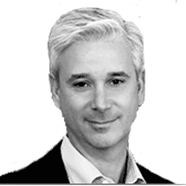
Board Bios
Charles W. Scharf
Chief Executive Officer, The Bank of New York Mellon Corporation
Charles Scharf is the chief executive officer at The Bank of New York Mellon Corporation.
Scharf served as chief executive officer and a director of Visa Inc., the world’s largest consumer payment system, from November 2012 to November 2016.
Before joining Visa, Scharf was a managing director of One Equity Partners, the private investment arm of JPMorgan Chase & Co. Previously, he served as chief executive officer of Retail Financial Services at JPMorgan Chase & Co. from 2004 to 2011, and as chief executive officer of the retail division of Bank One Corp. from 2002 to 2004.
Scharf also served as chief financial officer of Bank One Corp. from 2000 to 2002, chief financial officer of the Global Corporate and Investment Bank division at Citigroup from 1999 to 2000, and chief financial officer of Salomon Smith Barney and its predecessor company from 1995 to 1999.
Scharf joined the Microsoft board of directors in October 2014. He also serves on the board of Visa, and is a member of the board of trustees of Johns Hopkins University. He holds a bachelor’s degree from Johns Hopkins University and a master of business administration degree from New York University.
Read more at https://news.microsoft.com/exec/charles-w-scharf/#6vzmJ7LP6pjcWrcs.99

Slide 22
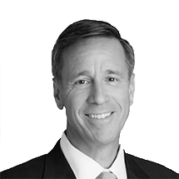
Board Bios
Arne Sorenson
President & Chief Executive Officer, Marriott International Inc.
Arne Sorenson is President and Chief Executive Officer of Marriott International Inc. In 2012, Sorenson became the third CEO in the company’s history, having held several positions since joining in 1996, including president and chief operating officer, chief financial officer and president of Continental European Lodging. He was elected to Marriott’s board of directors in 2011.
In addition, Sorenson served as vice chair, President’s Export Council, and is the immediate past board chair for Brand USA, where he remains a member of the board. He was most recently named chair, Global Initiative, to the board of directors of the Economic Club of Washington, D.C.
Other affiliations include chair, U.S. Travel Association CEO Roundtable; Luther College Board of Regents; Stewardship Board of the World Economic Forum System Initiative on Shaping the Future of Mobility; Business CEO Roundtable; and Board of Trustees for The Brookings Institution.
Before Marriott, Sorenson was a partner with law firm Latham & Watkins in Washington, D.C.
Sorenson joined the Microsoft board as an independent director in November 2017.
Read more at https://news.microsoft.com/exec/arne-sorenson/

Slide 23
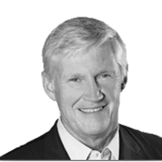
Board Bios
John W. Stanton
Chairman, Trilogy Equity Partners
John W. Stanton is chairman of Trilogy Equity Partners, a private equity fund that invests in early stage growth opportunities in the wireless ecosystem, and Trilogy International Partners, a wireless operator in Central and South America and New Zealand.
Stanton led four of the top wireless operators in the United States over the last 32 years, and operated wireless networks in Europe, Africa, Central and South America, and New Zealand.
During the 1980s, he served as chief operating officer and vice chairman of McCaw Cellular. From 1992 to 2005, he served as chairman and chief executive officer of Western Wireless Corp. Between 1995 and 2003, he served as chairman and chief executive officer of VoiceStream Wireless, which was acquired by Deutsche Telekom and subsequently renamed T-Mobile USA. He also served as director and later chairman of Clearwire Corp. from 2008 to 2013.
In the last decade Stanton has chaired or co-chaired the Business Partnership for Early Learning, the United Way of King County campaign, the Washington Roundtable and the Regional Transportation Commission. He presently serves as the chairman of Year Up of Puget Sound, a trustee of Whitman College and a director of the Seattle Foundation. In August of 2016, he was appointed chairman of First Avenue Entertainment LLLP, owner of the Seattle Mariners.
Stanton joined the Microsoft board in July 2014. He also serves on the board of directors of Columbia Sportswear Co., and Costco Wholesale.
Stanton has a bachelor’s degree in political science from Whitman College and an MBA from Harvard University. He is married and has two sons.
Read more at https://news.microsoft.com/exec/john-w-stanton/#4Vi5J01Bo1ZZI8J3.99

Slide 24
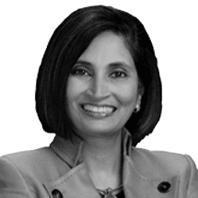
Board Bios
Padmasree Warrior
CEO and Chief Development Officer, NIO USA, Inc.
Padmasree Warrior is CEO and chief development officer of NIO USA, Inc. Warrior joined the Microsoft board of directors in December 2015.
From 2008 to 2012, Warrior was chief technology officer and co-led the engineering organization at Cisco Systems. She served as chief technology and strategy officer for Cisco through May 2015, and then strategic advisor through September 2015. Prior to Cisco, Warrior served in various executive roles at Motorola, Inc., a mobile device and telecommunications company, most recently as executive vice president and chief technology officer from 2003 to 2007.
Warrior holds a B.S. in chemical engineering from the Indian Institute of Technology in New Delhi and an M.S. in chemical engineering from Cornell University. She currently serves as a member of the board of directors for NIO USA, Inc.
Read more at https://news.microsoft.com/exec/padmasree-warrior/#ZDg2zGswUFdpzB0c.99

Slide 25
Executive Bios
Section 3

Slide 26
Executive Bios
Satya Nadella
Chief Executive Officer
Satya Nadella is Chief Executive Officer of Microsoft. Before being named CEO in February 2014, Nadella held leadership roles in both enterprise and consumer businesses across the company.
Joining Microsoft in 1992, he quickly became known as a leader who could span a breadth of technologies and businesses to transform some of Microsoft’s biggest product offerings.
Most recently, Nadella was executive vice president of Microsoft’s Cloud and Enterprise group. In this role he led the transformation to the cloud infrastructure and services business, which outperformed the market and took share from competition. Previously, Nadella led R&D for the Online Services Division and was vice president of the Microsoft Business Division. Before joining Microsoft, Nadella was a member of the technology staff at Sun Microsystems.
Originally from Hyderabad, India, Nadella lives in Bellevue, Wash. He earned a bachelor’s degree in electrical engineering from Mangalore University, a master’s degree in computer science from the University of Wisconsin – Milwaukee and a master’s degree in business administration from the University of Chicago. Nadella serves on the board of trustees to Fred Hutchinson Cancer Research Center as well as the Starbucks Board of Directors. He is married and has three children.
Read more at https://news.microsoft.com/exec/satya-nadella-2/#DD58Z7tXFasEpgkW.99

Slide 27
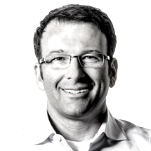
Executive Bios
Judson Althoff
Executive Vice President, Worldwide Commercial Business
As executive vice president of the Worldwide Commercial Business organization, Judson Althoff leads Microsoft’s commercial business strategy, including enterprise, public sector, small and mid-market, services, developer and partner. His organization is responsible for leading the digital transformation for commercial customers and partners to realize greater business value through the use of technology. Althoff is passionate about creating fans and advocates by bringing Microsoft’s bold ambitions to life for customers and partners, enabling their journey to the cloud.
Prior to this role, Althoff was president of Microsoft North America, responsible for commercial and public sector customers and partners as well as the retail and operator channel consumer business across the United States and Canada. During this time, he drove double digit revenue growth on a $30B business, and triple digit cloud growth across North America.
Althoff joined Microsoft in March 2013. Prior to this, Althoff spent 14 years at Oracle where he most recently served as senior vice president, and also spent several years at EMC.
Althoff holds a degree in mechanical engineering from Illinois Institute of Technology. He sits on the Illinois Institute of Technology Computer Science Advisory Board and is a co-chair of Free the Children’s Seattle WE Day. Originally from Ohio, Althoff resides in Seattle with his wife and four children.
Read more at https://news.microsoft.com/exec/judson-althoff/#mwLeWxAiUj5S2qWW.99

Slide 28

Executive Bios
Chris Capossela
Chief Marketing Officer and Executive Vice President, Marketing and Consumer Business
Chris Capossela is Microsoft’s chief marketing officer and executive vice president of Marketing and Consumer Business. Capossela runs marketing for Microsoft’s consumer and commercial businesses, which includes product marketing for all Microsoft services and products, brand, advertising, communications and research. As leader of the Consumer Business team, Capossela oversees the Consumer and Device Sales team, Microsoft Advertising sales and Microsoft Stores. These teams are collectively responsible for driving revenue, growth and share across our consumer businesses.
In his more than 25 years at Microsoft, Capossela has held a variety of leadership roles. Previously, he served in the Microsoft Office Division and was responsible for marketing the company’s productivity solutions including Microsoft Office, Office 365, SharePoint, Exchange, Lync, Project and Visio.
More recently, he served as the worldwide leader of the Consumer Channels Group, responsible for sales and marketing activities with OEM, operator and retail partners. During this time, he oversaw the creation of new business opportunities with partners to deliver new consumer experiences through Windows, Windows Phone, Office and Xbox.
Capossela holds a bachelor’s degree in computer science and economics from Harvard University. His interest in technology and computing began when, as a boy, he wrote a reservation system for his family’s small Italian restaurant in Boston using dBASE for DOS on an early IBM PC. Originally from Boston, Capossela lives in Seattle with his wife and two daughters. He is passionate about Microsoft’s mission to empower every person and organization on the planet to achieve more and currently serves as a board member for Worldreader, a non-profit dedicated to bringing digital books to every child and her family, so that they can improve their lives.
Read more at https://news.microsoft.com/exec/chris-capossela/#pfDzijJ21b3vYMWc.99

Slide 29
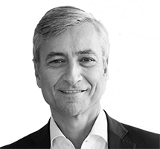
Executive Bios
Jean-Philippe Courtois
Executive Vice President and President, Microsoft Global Sales, Marketing and Operations
As executive vice president and president, Global Sales, Marketing & Operations, Jean-Philippe Courtois’ scope includes both Microsoft’s commercial and consumer business across 118 countries worldwide. From cloud services to devices, Courtois is responsible for driving strategic planning, running global operations and shaping growth initiatives in developed and emerging markets. Courtois is passionate about helping businesses digitally transform with the right strategy, support and technology to unlock new ways of working, new business models and new revenue streams. With customers and employees expecting more, Courtois advocates the strategic implementation of intelligent cloud services to maintain competitive edge.
Previously, Courtois served as president of Microsoft International where he led sales, marketing and services across all Microsoft subsidiaries outside of the United States and Canada. Before that he held the same role for the EMEA region (Europe, Middle East and Africa) as CEO and president of Microsoft EMEA, and outside of EMEA, Courtois was corporate vice president of Worldwide Customer Marketing, based out of Microsoft’s worldwide headquarters in Redmond, Washington.
Courtois joined Microsoft in 1984. His first role was as a channel sales representative and, after holding several leadership positions, he was promoted to general manager for Microsoft France in 1994.
Courtois holds a Diplôme des Etudes Commerciales Supérieures (DECS) from the Ecole Supérieure de Commerce, Nice (SKEMA). Outside of Microsoft, Courtois is chairman of the board of directors for SKEMA Business School, as well as a board member of Positive Planet, a worldwide leading NGO with a mission to help men and women across the world create the conditions for a better life for future generations. He has served as co-chairman of the World Economic Forum’s Global Digital Divide Initiative Task Force, on the European Commission Information and Communication Technology task force and previously sat on the board of directors for AstraZeneca. More recently, he co-founded the foundation “Live for Good,” which aims to help underprivileged young social entrepreneurs realize their potential.
Read more at https://news.microsoft.com/exec/jean-philippe-courtois-2/#lL5GTJL6vv0k9WVz.99

Slide 30
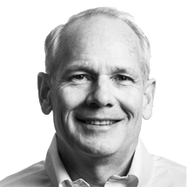
Executive Bios
Kurt DelBene
Chief Digital Officer and Executive Vice President, Corporate Strategy, Core Services Engineering and Operations
Kurt DelBene is Microsoft’s chief digital officer and executive vice president of Corporate Strategy, Core Services Engineering and Operations, leading the company’s cross-engineering and cross-business strategy, execution and planning initiatives.
DelBene, previously with Microsoft as president of the Office Division, rejoined Microsoft in April 2015 after helping President Obama make improvements to Healthcare.gov, the enrollment website for the Affordable Care Act, and after being a venture partner with Madrona Venture Group.
From December 2013 to July 2014, in his work on Healthcare.gov as senior advisor to the Secretary of Health and Human Services, DelBene helped assess and implement the path through the first Open Enrollment period, including troubleshooting issues encountered along the way, and setting the project up for long-term success. He was also the liaison to White House and Health and Human Services senior leadership.
As president of the Microsoft Office Division from 2010-2013, DelBene was responsible for driving Microsoft’s global productivity strategy for information workers. DelBene oversaw the engineering and marketing functions for a wide range of productivity products and services, including Office, Office 365, Exchange, SharePoint, Lync, Project and Visio.
Previously, he served as the senior vice president for the Microsoft Business Division, responsible for the development of client and server software that collectively delivers to organizations and individuals a holistic productivity experience, including authoring, collaboration, communications, information sharing and project management. In this role, he oversaw development teams in the Office engineering organization including Office desktop applications, Office Web Applications, Microsoft SharePoint, Microsoft Exchange Server, Microsoft Office Communications Server and Office Labs.
DelBene joined Microsoft in 1992 and has served in several roles in Microsoft’s product development teams. He served as vice president of Authoring and Collaboration Services, responsible for the development of Office’s document and Web-page authoring and collaboration products. He also served as the general manager of Microsoft Outlook, Microsoft’s messaging and personal-information-management application. He has also served as group program manager for Microsoft Exchange, responsible for the Microsoft Exchange client and Schedule+, and group manager in Microsoft’s Systems Division, responsible for fax and embedded systems software.
Prior to joining Microsoft, DelBene was a management consultant with McKinsey and Company, focusing on business strategy for technology companies. He has also worked as a software developer and systems engineer for AT&T Bell Laboratories, working in graphics and imaging software and network switching systems.
DelBene holds a Master of Business Administration degree from the University of Chicago, a Master of Science degree from Stanford University and a Bachelor of Industrial Engineering from the University of Arizona.
Read more at https://news.microsoft.com/exec/kurt-delbene-2/#L0b6jJCY07PC87Pw.99

Slide 31
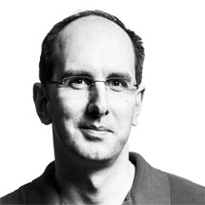
Executive Bios
Scott Guthrie
Executive Vice President, Microsoft Cloud + AI Group
As executive vice president of the Microsoft Cloud + AI Group, Scott Guthrie is responsible for the company’s computing fabric (cloud and edge, including cloud infrastructure, server, database, CRM, ERP, management) and Artificial Intelligence platform (infrastructure, runtimes, frameworks, tools and higher-level services around perception, knowledge and cognition).
Prior to leading the Cloud + AI Group, Guthrie helped lead Microsoft Azure, Microsoft’s public cloud platform. Since joining the company in 1997, he has made critical contributions to many of Microsoft’s key cloud, server and development technologies and was one of the original founders of the .NET project. Guthrie graduated with a bachelor’s degree in computer science from Duke University.
Read more at https://news.microsoft.com/exec/scott-guthrie/

Slide 32
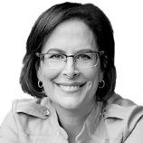
Executive Bios
Kathleen Hogan
Executive Vice President, Human Resources
As Chief People Officer and executive vice president of Human Resources at Microsoft, Kathleen Hogan empowers 100,000+ global employees to achieve Microsoft’s mission. In her role, she focuses on making Microsoft an exceptional place for employees to work, and ensures that the company is creating a culture that attracts and inspires the world’s most passionate talent.
Hogan previously served as corporate vice president of Microsoft Services, a team dedicated to helping businesses and consumers maximize the value of their investment in Microsoft technologies. She has also served as corporate vice president of Customer Service and Support. Prior to joining Microsoft in 2003, Hogan worked at McKinsey & Co. and Oracle Corp.
Hogan earned her bachelor’s degree in applied mathematics and economics, magna cum laude, from Harvard University. In addition, she holds an M.B.A. from the Stanford University Graduate School of Business. She sits on the board of directors of the Puget Sound affiliate of Susan G. Komen for the Cure and the National Center for Women & Information Technology.
Read more at https://news.microsoft.com/exec/kathleen-hogan/#OEB5kYkgGMRt7Avq.99

Slide 33
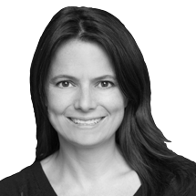
Executive Bios
Amy Hood
Executive Vice President and Chief Financial Officer
As chief financial officer, Amy Hood is responsible for leading Microsoft’s worldwide finance organization, including acquisitions, treasury activities, tax planning, accounting and reporting, and internal audit and investor relations.
Prior to this role, Hood was chief financial officer of Microsoft’s Business Division, responsible for the company’s productivity applications and services including Microsoft Office 365, Office, SharePoint, Exchange, Dynamics ERP and Dynamics CRM. During her time in the Business Division, Hood helped lead the transition to the company’s Office 365 service, and she was deeply involved in the strategy development and overall execution of the company’s successful acquisitions of Skype and Yammer.
Hood joined Microsoft in 2002 and previously held positions in the Server and Tools Business as well as the corporate finance organization. Prior to 2002, she worked at Goldman Sachs & Co. in various investment banking and capital markets groups roles.
Hood earned a bachelor’s degree in economics from Duke University and a master’s degree in business administration from Harvard University. Hood lives in Seattle with her husband and daughters.
Read more at https://news.microsoft.com/exec/amy-hood/#yi8RZm2W4sDtDr0U.99

Slide 34
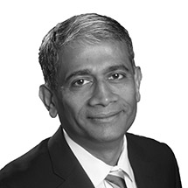
Executive Bios
Rajesh Jha
Executive Vice President, Experiences & Devices
As executive vice president of Microsoft’s Experiences and Devices Group, Rajesh Jha leads the team that includes Devices, Windows client, New Experiences and Technology, Enterprise Mobility and Management, and Office Product Group.
Recently he was corporate vice president, leading teams that helped reinvent productivity and collaboration including delivering Office 365 cross platform and through the cloud. Office 365 is one of the fastest-growing commercial services in the industry and is used by businesses, governments and educational institutions worldwide, providing powerful security controls, advanced analytics and voice communication.
Jha started at Microsoft right out of university in 1990. He began his career as a software design engineer, working on various clients, servers and services during his tenure. Jha has a master’s degree in computer science from the University of Massachusetts, Amherst and a bachelor’s degree in computer science from Indian Institute of Technology, Madras.
Read more at https://news.microsoft.com/exec/rajesh-jha/#36LI82e0RgoD2hcc.99

Slide 35

Executive Bios
Peggy Johnson
Executive Vice President, Business Development
As executive vice president of business development, Peggy Johnson is responsible for driving strategic partnerships and transactions to accelerate growth for Microsoft and its customers. Johnson works with external partners around the world, ranging from start-ups to large-scale enterprises, to identify areas of collaboration, drive innovation and unlock shared value. In this capacity, she also manages Microsoft’s relationship with the venture capital community and oversees strategic investments through the company’s corporate venture fund, Microsoft Ventures.
Prior to this role, Johnson spent 24 years at Qualcomm, where she served as a member of Qualcomm’s Executive Committee. During her time at Qualcomm, Johnson held various leadership positions across engineering, sales, marketing and business development, and ran the Qualcomm Internet Services business unit. Most recently, Johnson was executive vice president of Qualcomm Technologies, Inc., and president of global market development, where she was responsible for commercializing new business opportunities and developing strategic relationships for the company.
Prior to joining Qualcomm, Johnson worked as an engineer for General Electric’s Military Electronics Division.
Johnson earned her bachelor’s degree in electrical engineering from San Diego State University. She serves on the board of directors for Live Nation Entertainment, Inc and the international non-profit PATH. She has been recognized by multiple organizations, including Business Insider (“#1 Most Powerful Female Engineer in 2017”), Silicon Republic (“40 Powerful Women Leading Tech Around the World”), Connected World Magazine (“2014 Women of M2M List”), Women in Technology International (“2013 Hall of Fame Award”) and STEM (“100 Women Leaders in STEM, 2012″).
Johnson lives in the Seattle area with her husband, the youngest of their three children, four dogs and one cat.
Read more at https://news.microsoft.com/exec/peggy-johnson/#kmDrG8DoD2Wrj7Ar.99

Slide 36

Executive Bios
Kevin Scott
Chief Technology Officer & Executive Vice President
As executive vice president and chief technology officer of Microsoft, Kevin Scott’s 20-year career in technology spans both academia and industry as researcher, engineer and leader.
Scott is an innovative leader who drives the technical vision forward in achieving Microsoft’s mission, and is passionate about creating technologies that benefit everyone. He focuses on helping make the company an exceptional place for engineers, developers and researchers to work and learn.
Prior to joining Microsoft, Scott was senior vice president of engineering and operations at LinkedIn, where he helped build the technology and engineering team and led the company through an IPO and six years of rapid growth.
Earlier in his career history, he oversaw mobile ads engineering at Google, including the integration of Google’s $750 million acquisition of AdMob. At AdMob, Scott was responsible for engineering and operations for the world’s leading platform for mobile monetization. Before joining AdMob, Scott held numerous leadership positions at Google in search and ads engineering and helped with the company’s early efforts establishing remote engineering centers.
Scott is the host of the podcast Behind the Tech, which features interviews with technology heroes who have helped create the tech industry of today.
As co-inventor on several patents around search and information extraction, he has also authored several publications on dynamic binary rewriting that collectively have been cited hundreds of times in other scholarly research.
A recipient of a Google Founder’s Award, Scott has also received an Intel Ph.D. Fellowship and an ACM Recognition of Service award. Scott was a founding member of the ACM Professions Board, a member of the startup Magic’s board of directors and a trustee of The Scott Foundation.
He is an adviser to several Silicon Valley startups, an active angel investor, the founder of the non-profit organization Behind the Tech and an emeritus trustee of the Anita Borg Institute.
Scott holds an M.S. in computer science from Wake Forest University, a B.S. in computer science from Lynchburg College, and completed most of his Ph.D. in computer science at the University of Virginia.
Read more at https://news.microsoft.com/exec/kevin-scott/#ERBZjzjfEeAO8hvR.99

Slide 37
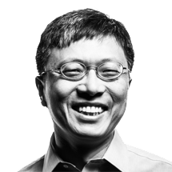
Executive Bios
Harry Shum
Executive Vice President, Artificial Intelligence and Research Group
Harry Shum is executive vice president of Microsoft’s Artificial Intelligence (AI) and Research group.
He is responsible for driving the company’s overall AI strategy and forward-looking research and development efforts spanning infrastructure, services, apps and agents. He oversees AI-focused product groups — the Information Platform Group, Bing and Cortana product groups — and the Ambient Computing and Robotics teams.
He also leads Microsoft Research, one of the world’s premier computer science research organizations, and its integration with the engineering teams across the company.
Previously, Dr. Shum served as the corporate vice president responsible for Bing search product development from 2007 to 2013. Prior to his engineering leadership role at Bing and online services, he oversaw the research activities at Microsoft Research Asia and the lab’s collaborations with universities in the Asia Pacific region, and was responsible for the Internet Services Research Center, an applied research organization dedicated to advanced technology investment in search and advertising at Microsoft.
Dr. Shum joined Microsoft Research in 1996 as a researcher based in Redmond, Washington. In 1998 he moved to Beijing as one of the founding members of Microsoft Research China (later renamed Microsoft Research Asia). There he began a nine-year tenure as a researcher, subsequently moving on to become research manager, assistant managing director and managing director of Microsoft Research Asia and a Distinguished Engineer.
Dr. Shum is an IEEE Fellow and an ACM Fellow for his contributions to computer vision and computer graphics. He received his Ph.D. in robotics from the School of Computer Science at Carnegie Mellon University. In 2017, he was elected to the National Academy of Engineering of the United States.
Read more at https://news.microsoft.com/exec/harry-shum/#rYUPLoDdRM860KCB.99

Slide 38
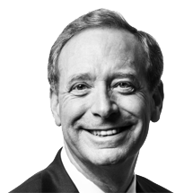
Executive Bios
Brad Smith
President and Chief Legal Officer
Brad Smith is Microsoft’s president and chief legal officer.
In this role Smith is responsible for the company’s corporate, external, and legal affairs. He leads a team of more than 1,300 business, legal and corporate affairs professionals working in 55 countries. These teams are responsible for the company’s legal work, its intellectual property portfolio, patent licensing business, corporate philanthropy, government affairs, public policy, corporate governance, and social responsibility work. He is also Microsoft’s chief compliance officer. Smith plays a key role in representing the company externally and in leading the company’s work on a number of critical issues including privacy, security, accessibility, environmental sustainability and digital inclusion, among others.
Smith joined Microsoft in 1993, and before becoming general counsel in 2002 he spent three years leading the Legal and Corporate Affairs (LCA) team in Europe, then five years serving as the deputy general counsel responsible for LCA’s teams outside the United States.
Smith has overseen numerous negotiations leading to competition law and intellectual property agreements with governments around the world and with companies across the IT sector. He has played a leading role within Microsoft and in the IT sector on government surveillance, privacy, intellectual property, immigration and computer science education policy issues. As the senior executive responsible for ensuring Microsoft fulfills its corporate responsibilities, he has helped the company achieve its consistent ranking in the top 2 percent of the S&P 500 for corporate governance scores. He has played a leadership role locally and nationally on numerous charitable, business and legal initiatives. In 2013 he was named by the National Law Journal as one of the 100 most influential lawyers in the United States. In 2014, the New York Times called Smith “a de facto ambassador for the technology industry at large.”
In addition to his work at Microsoft, Smith is active in several civic and legal organizations and in the broader technology industry. In March 2015, Smith joined the Netflix board of directors. He also works to advance several significant diversity and pro bono initiatives, serving as chair of the board of directors of Kids in Need of Defense (KIND) and as chair of the Leadership Council on Legal Diversity (LCLD). In addition, Smith chairs the board of the Washington State Opportunity Scholarship program, at the appointment of the governor.
Smith grew up in Appleton, Wisconsin, where Green Bay was the big city next door. He attended Princeton University, where he met his wife, Kathy (also a lawyer), and graduated summa cum laude with a concentration in international relations and economics. He earned his J.D. from the Columbia University School of Law and studied international law and economics at the Graduate Institute of International Studies in Geneva, Switzerland. Prior to joining Microsoft, he was an associate and then partner at the Washington, D.C.-based firm of Covington and Burling, where he is still remembered as the first attorney in the long history of the firm to insist (in 1986) on having a personal computer on his desk as a condition for accepting a job offer. He can be followed at http://twitter.com/@bradsmi.
Read more at https://news.microsoft.com/exec/brad-smith/#p0riYmZLK08MfXq2.99

Slide 39

Executive Bios
Phil Spencer
Executive Vice President, Gaming
Phil Spencer is executive vice president, Gaming at Microsoft.
In this role, Spencer is accountable for leading Microsoft’s gaming business across all devices and services. With his team and game development partners, Spencer continues to push the boundaries of creativity, technical innovation and fun across gaming genres, audiences and devices.
Spencer is both a passionate gamer and seasoned gaming executive serving more than 15 years in the gaming industry leading global business, creative and engineering teams. Spencer has held various roles across Microsoft including Head of Xbox, Corporate Vice President, Microsoft Studios, and GM, Microsoft Game Studios EMEA. In these roles, Spencer led the Xbox organization with the launches of Xbox One S and Xbox One X, the acquisition of Minecraft and influenced blockbuster game franchises from “Halo,” “Gears of War,” “Forza Motorsport,” as well as Microsoft Publishing. He’s also led the expansion of cross-platform gaming with Xbox Live, which now counts more than 50 million monthly active users.
Before beginning his career as an intern with Microsoft in 1988, Spencer earned his bachelor’s degree from the University of Washington. He currently serves on the board of Entertainment Software Association and of First Tee of Greater Seattle. Spencer has two daughters in college and lives with his wife in the Seattle area. He can be followed on Twitter at @XboxP3.
Read more at https://news.microsoft.com/exec/phil-spencer-2/

Slide 40
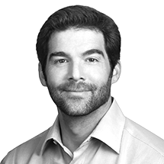
Executive Bios
Jeff Weiner
CEO of LinkedIn
Jeff Weiner is the CEO of LinkedIn, the world’s largest and most powerful network of professionals. Weiner joined LinkedIn in December 2008, and under his leadership LinkedIn has grown its membership from 33 million to more than 467 million, increased its annual revenue from $78 million to $3.7 billion, and gone from 338 employees to more than 10,000 full-time employees in more than 30 offices around the world.
Before LinkedIn, Weiner was an executive in residence at Accel Partners and Greylock Partners, where he advised the firms’ consumer technology portfolio companies and evaluated new investment opportunities. Previously, Weiner served as executive vice president of Yahoo!’s Network Division, a business that generated $3 billion in annual revenue with more than 3,000 employees and had responsibility for many of the company’s consumer-facing and industry-leading products.
Prior to joining Yahoo! in 2001, Weiner spent more than six years at Warner Bros., where he helped oversee the company’s online efforts and developed the initial business plan for Warner Bros. Online in 1994.
In addition to LinkedIn, Weiner serves on the board of directors for Intuit Inc. and DonorsChoose.org, and the board of advisors for Venture for America and the Boys & Girls Club of the Peninsula. He holds a BS in economics from The Wharton School at the University of Pennsylvania.
Read more at https://news.microsoft.com/exec/jeff-weiner/#R2YVLPOf52pLdHqs.99

Slide 41
Board Calendar
Section 4

Slide 42
Board Calendar 2019
Board/Committee | Confirmed Date | Confirmed Time/Place
Board and Committee Meetings | Tuesday, June 11 | 7:30 AM – 6:00 PM PT
Board of Directors Dinner | Tuesday, June 11 | 6:00 – 8:30 PM PT
Board of Directors Meeting | Wednesday, June 12 | 8:00 AM – 4:00 PM PT
Board of Directors International Meeting (Dublin, Ireland) | Monday, September 16 – 19 | TBD
Board and Committee Meetings | Tuesday, December 3 | 7:30 AM – 6:00 PM PT
Board of Directors Dinner | Tuesday, December 3 | 6:00 – 8:30 PM PT
Microsoft Annual Shareholders Meeting | Wednesday, December 4 | 8:00 – 9:30 AM PT
Board of Directors Meeting | Wednesday, December 4 | 10:00 AM – 4:00 PM PT

Slide 43
Board Calendar 2020
Board/Committee | Confirmed Date | Confirmed Time/Place
Board and Committee Meetings | Monday, March 16 | 7:30 AM – 6:00 PM PT
Board of Directors Retreat Day 1 | Monday, March 16 | 4:00 – 9:00 PM PT
Board of Directors Retreat Day 2 | Tuesday, March 17 | 8:00 AM – 4:00 PM PT
Board and Committee Meetings | Tuesday, June 16 | 7:30 AM – 6:00 PM PT
Board of Directors Dinner | Tuesday, June 16 | 6:00 – 8:30 PM PT
Board of Directors Meeting | Wednesday, June 17 | 8:00 AM – 4:00 PM PT
Board and Committee Meetings | Monday, September 14 | 7:30 AM – 6:00 PM PT
Board of Directors Dinner | Monday, September 14 | 6:00 – 8:30 PM PT

Slide 44
Board Calendar 2020, continued
Board/Committee | Confirmed Date | Confirmed Time/Place
Board of Directors Meeting | Tuesday, September 15 | 8:00 AM – 4:00 PM PT
Board and Committee Meetings | Tuesday, December 1 | 7:30 AM – 6:00 PM PT
Board of Directors Dinner | Tuesday, December 1 | 6:00 – 8:30 PM PT
Microsoft Annual Shareholders Meeting | Wednesday, December 2 | 8:00 AM – 9:30 AM PT
Board of Directors Meeting | Wednesday, December 2 | 10:00 AM – 4:00 PM PT

Slide 45
Director Compensation
Section 5

Slide 46
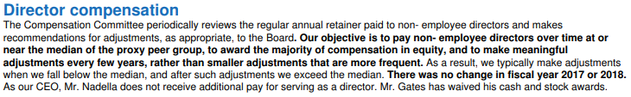
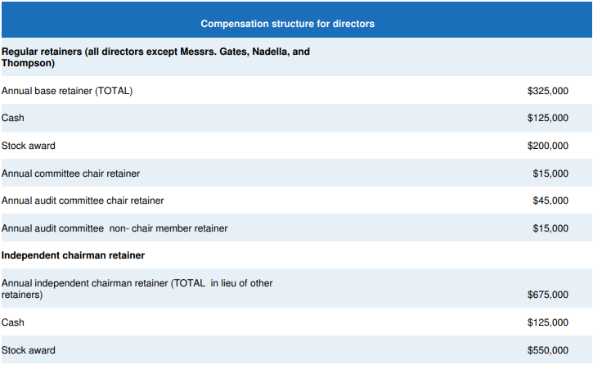
Director Compensation
Source: Company Proxy (2018)

